Slide 1

OPERATING SYSTEM
ADITYA COLLEGE OF ENGINEERING &
TECHNOLOGY
(Process concepts)
(Unit-2)

Slide 2
Contents
Aditya College of Engineering &
Technology
Process
Process Control Block
Process State Diagram
Operations on process

Slide 3
Process
Aditya College of Engineering &
Technology
A Program does nothing unless its instructions are executed by a CPU.
A program in execution is called a process.
In order to accomplish its task, process needs the computer resources.
There may exist more than one process in the system which may require the same resource at the same time.
Therefore, the operating system has to manage all the processes and the resources in a convenient and efficient way.
When a program is loaded into the memory and it becomes a process, it can be divided into four sections ─ stack, heap, text and data.

Slide 4
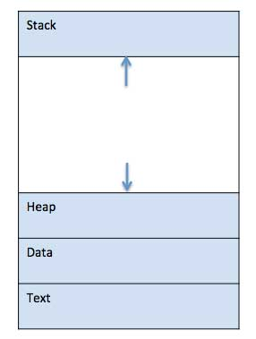
Layout of a process inside main memory
Aditya College of Engineering &
Technology
1 | Stack The process Stack contains the temporary data such as method/function parameters, return address and local variables.
2 | Heap This is dynamically allocated memory to a process during its run time.
3 | Text This includes the current activity represented by the value of Program Counter and the contents of the processor's registers.
4 | Data This section contains the global and static variables.

Slide 5
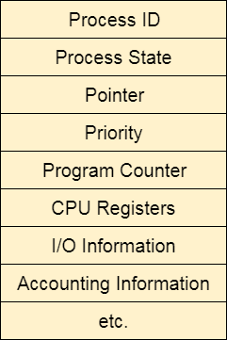
Process Control Block
Aditya College of Engineering &
Technology
A Process Control Block is a data structure maintained by the Operating System for every process. The PCB is identified by an integer process ID (PID).
The architecture of a PCB is completely dependent on Operating System and may contain different information in different operating systems.

Slide 6
Aditya College of Engineering &
Technology
Process State
The current state of the process i.e., whether it is ready, running, waiting, or whatever.
Process ID
Unique identification for each of the process in the operating system.
Pointer
A pointer to parent process.
Program Counter
Program Counter is a pointer to the address of the next instruction to be executed for this process.
CPU registers
Various CPU registers where process need to be stored for execution for running state.
CPU Scheduling Information
Process priority and other scheduling information which is required to schedule the process.
Memory management information
This includes the information of page table, memory limits, Segment table depending on memory used by the operating system.
Accounting information
This includes the amount of CPU used for process execution, time limits, execution ID etc.
IO status information
This includes a list of I/O devices allocated to the process.

Slide 7
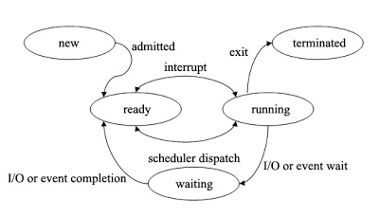
Process State Diagram
Aditya College of Engineering &
Technology

Slide 8
Aditya College of Engineering &
Technology
New: A program which is going to be picked up by the OS into the main memory is called a new process.
Ready:Whenever a process is created, it directly enters in the ready state, in which, it waits for the CPU to be assigned.
Running:One of the processes from the ready state will be chosen by the OS depending upon the scheduling algorithm.
Block or wait:When a process waits for a certain resource to be assigned or for the input from the user then the OS move this process to the block or wait state and assigns the CPU to the other processes.
Completion or termination: When a process finishes its execution, it comes in the termination state. All the context of the process (Process Control Block) will also be deleted the process will be terminated by the Operating system.

Slide 9
Different Operations on Processes
Aditya College of Engineering &
Technology
There are many operations that can be performed on processes.
process creation
process preemption
process blocking
process termination

Slide 10
Process Creation
Aditya College of Engineering &
Technology
Processes need to be created in the system for different operations. This can be done by the following events −
User request for process creation
System initialization
Execution of a process creation system call by a running process
Batch job initialization
A process may be created by another process using fork() in unix Environment.
The creating process is called the parent process and the created process is the child process. A child process can have only one parent but a parent process may have many children.
Each of these new processes may in turn create other processes forming a tree of processes.

Slide 11
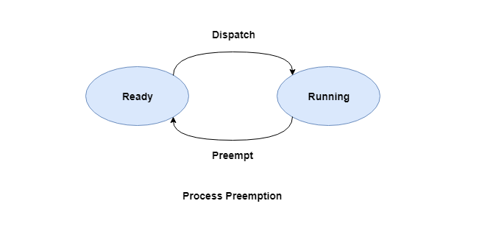
Process Preemption
Aditya College of Engineering &
Technology
An interrupt mechanism is used in preemption that suspends the process executing currently and the next process to execute is determined by the short-term scheduler.
Preemption makes sure that all processes get some CPU time for execution.

Slide 12
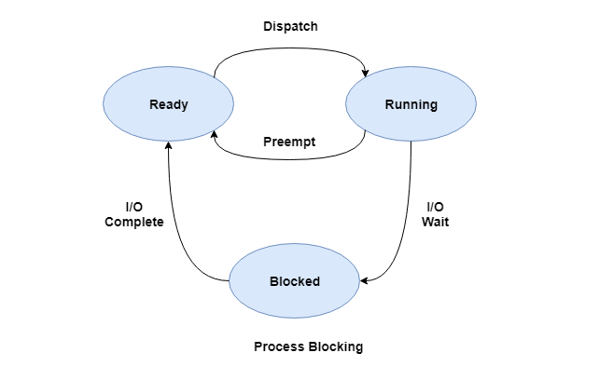
Process Blocking
Aditya College of Engineering &
Technology
The process is blocked if it is waiting for some event to occur.
This event may be I/O as the I/O events are executed in the main memory and don't require the processor.
After the event is complete, the process again goes to the ready state.

Slide 13
Process Termination
Aditya College of Engineering &
Technology
After the process has completed the execution of its last instruction, it is terminated.
The resources held by a process are released after it is terminated.

Slide 14
Aditya College of Engineering &
Technology
THANK YOU

